Slide 1
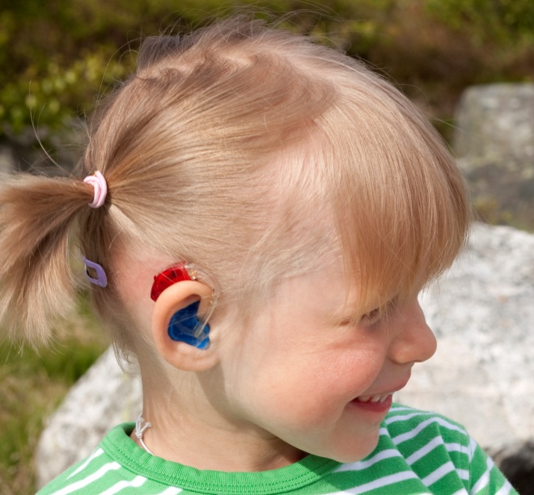
What you need to know about student’s hearing technology for classroom listening
?
microphone
?
receiver
battery door
FM
?
transmitter
?
audioshoe
desktop system
?
soundfield system
Ling sounds
Presentation developed by:
Gwen Severance, AuD & Patty Klein, AuD
September, 2012
?

Slide 2
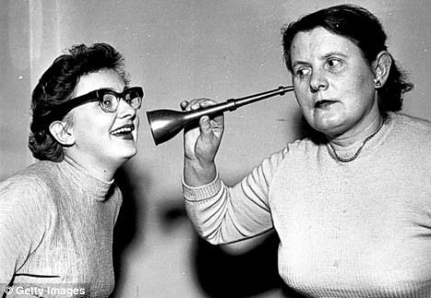
If only it were this easy………

Slide 3
There’s A LOT to cover!
Types of Equipment we have to offer our students
Listening checks – why and how to do them
Troubleshooting Equipment
Miscellaneous questions answered

Slide 4
Why DO students with hearing loss need classroom hearing technology? What are some benefits and limitations?

Slide 5
Children with Hearing Loss Need …hearing technology (personal or speaker systems)
Any child in ANY situation with background noise
Any child in ANY group situation
Any child in ANY situation where they are receiving new information
Any child in ANY situation where the speaker moves around the room
Any child who has ANY distortion in their hearing
Any child with a poorly developed language structure
Any child who is listening in their second language
Notes:
All students with suspected hearing loss should first be screened by Audiometry who will refer them to the ARU if they fail the audiometric screening.
Students may be further evaluated by the ARU or by their private physician/audiologist if needed.
Once identified by the ARU, the DHH Department along with the Audiologist will participate in the IEP to insure that appropriate services and supports are in place.

Slide 6
Why would some students with hearing loss NOT benefit from classroom hearing technology?

Slide 7

“Kid reasons,” not hearing reasons
Student refuses to wear hearing aids so an ear-level personal FM cannot be used
History of “losing” or purposely damaging hearing devices
Lack of tolerance to wearing equipment (autism spectrum, cognitive delay, etc)
Student excels academically with hearing aids alone and refuses to use an FM system
Systems challenges for sound field FM or using a desktop system in secondary school

Slide 8
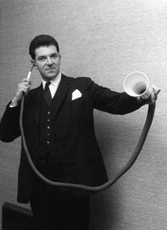
TYPES OF EQUIPMENT (the ones we have to offer, that is…)

Slide 9
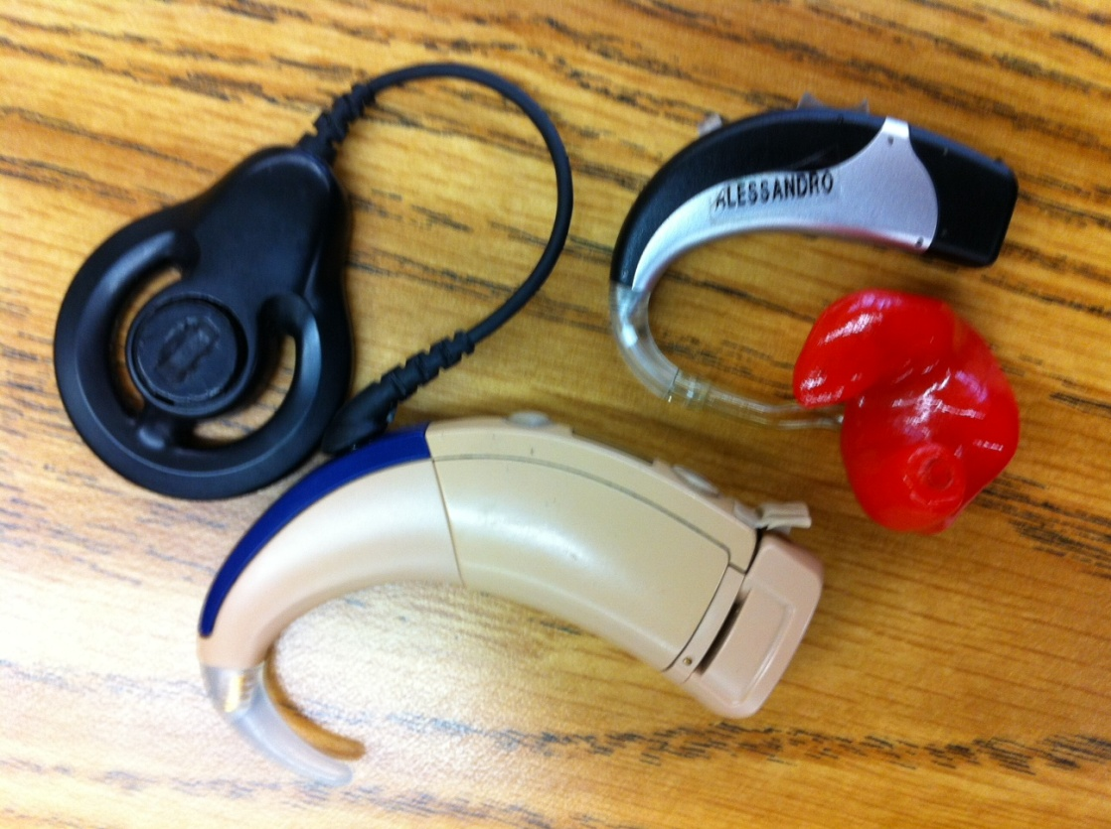
Personal (ear level) technology
FM receivers that attach to the
student’s hearing aid or cochlear implant

Slide 10
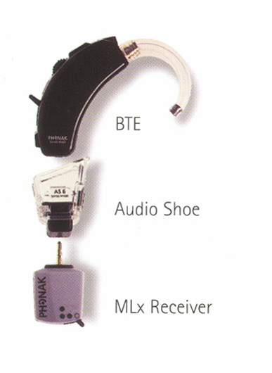
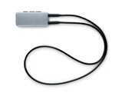
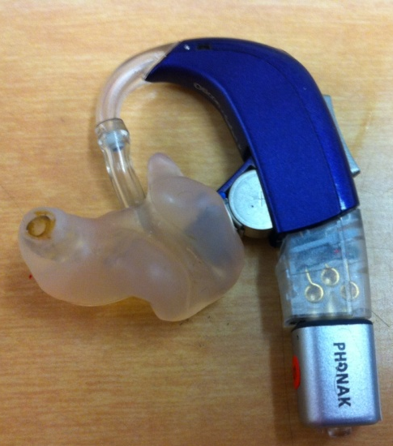
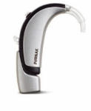
FM Receivers
I Link Hearing Aid (FM receiver built in)
M FM FM/M
MyLink Neckloop receiver worn with a hearing aid or CI (works with a hearing aid’s or CI’s telecoil setting)
Phonak Extra Hearing Aid hearing aid with FM receiver attached
Oticon Safari hearing aid with
FM9 audio shoe and
mlxi FM receiver

Slide 11
Most Popular Brands of Hearing Aids for our kids:
Phonak Oticon
Siemens Widex

Slide 12
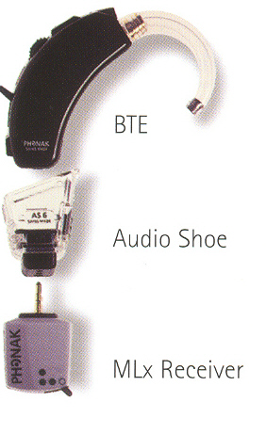
Different models of hearing aids need different kinds of audio shoes.
AND,
Most hearing aids need to be programmed for FM+Mic in order for the FM system to work.

Slide 13
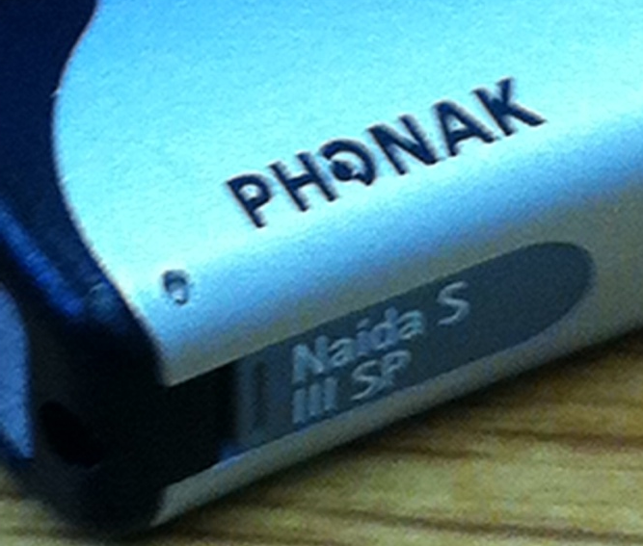
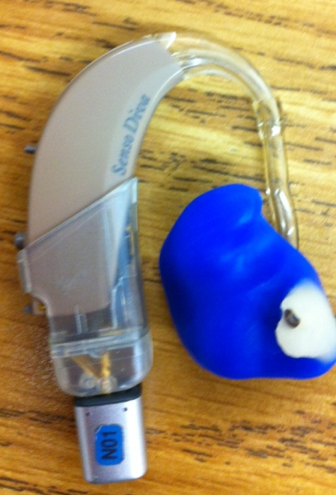
How do you know what kind of hearing aid a student has?
Most have a label somewhere on the hearing aid that tells you the make (brand) and model.

Slide 14
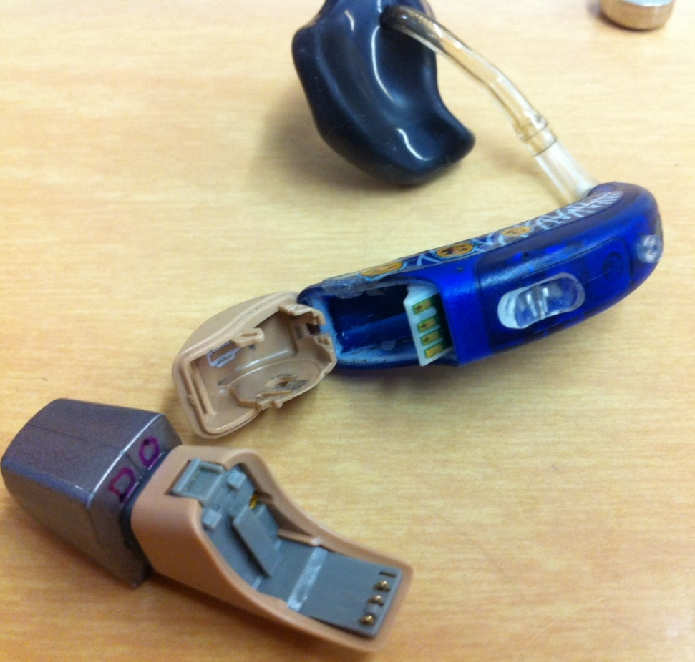
If it’s a Phonak,
it’s going to need a new battery door to accommodate the audio shoe!
An audiologist will have to do this
And, you’ll need verbal permission from the parent first

Slide 15
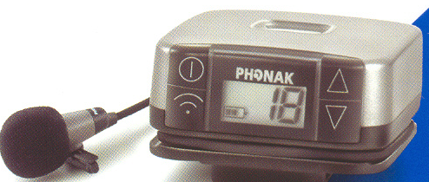
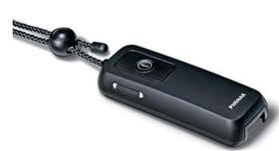
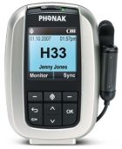

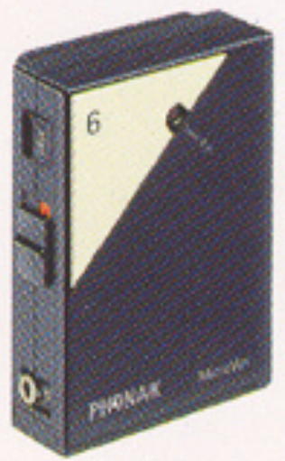
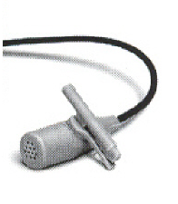
Types of Transmitters for ear level technology
EasyLink and
EasyLink+
Campus SX
Inspiro
TX2

Slide 16
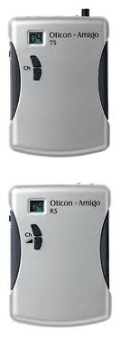
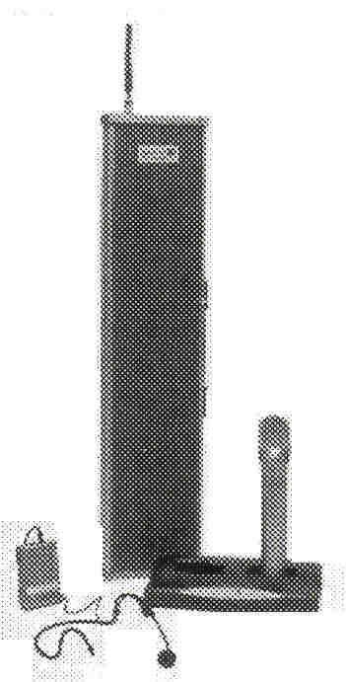
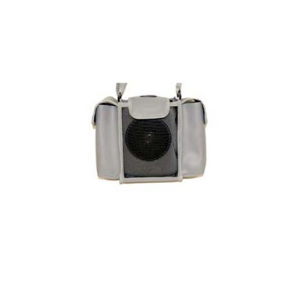
Other types of classroom technology
Easy Listener and Amigos (for one student)
Classroom speaker systems (soundfield)
Desktop Totable
(for one-two students)

Slide 17
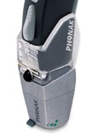
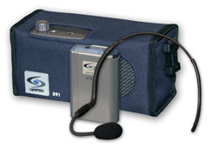
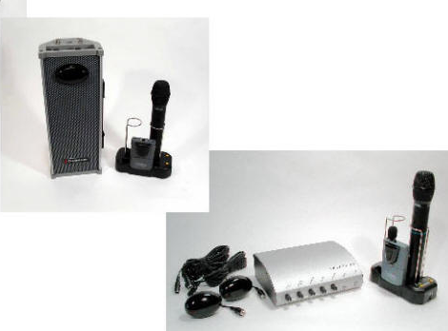

What is (usually) the most preferable kind of classroom hearing technology equipment to use? Why?

Slide 18

Sizing up classroom hearing technology
https://successforkidswithhearingloss.com/wp-content/uploads/2011/08/Benefit-of-3-SN-Enhancing-Devices-JEA-Anderson_et_al__20051.pdf

Slide 19


Distance from the teacher’s mouth to the student’s ear makes a big difference!
The farther the student is from the desired speaker the more noise and reverberation will interfere with speech understanding.
VS

Slide 20
So, if your student shows up with his first pair of hearing aids, or gets new hearing aids……. What’s the first question that should cross your mind?....

Slide 21
Would FM work for this student?
And,
Do I need to request anything different
from the audiologists?

Slide 22
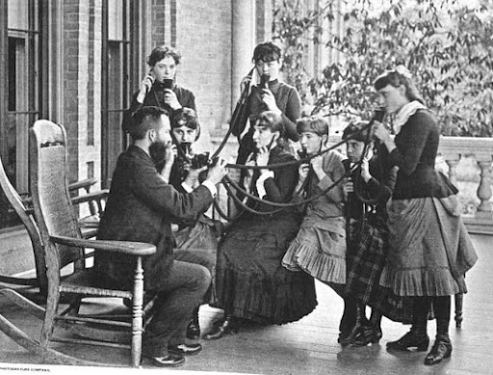
Listening checks

Slide 23

Why bother?
Ensure that the speech signal the child is receiving is clear
Alert you to malfunctioning equipment
Properly functioning amplification is essential to the success of any student with hearing loss!
Access denied is opportunity denied!

Slide 24

Oh yeah….and it’s the LAW!
*IDEA, 34 CFR 300.303 *Requires schools to “ensure that the hearing aids worn by children with hearing impairments…are functioning properly.” *HOWEVER….. The law does not state the frequency with which monitoring should occur.

Slide 25
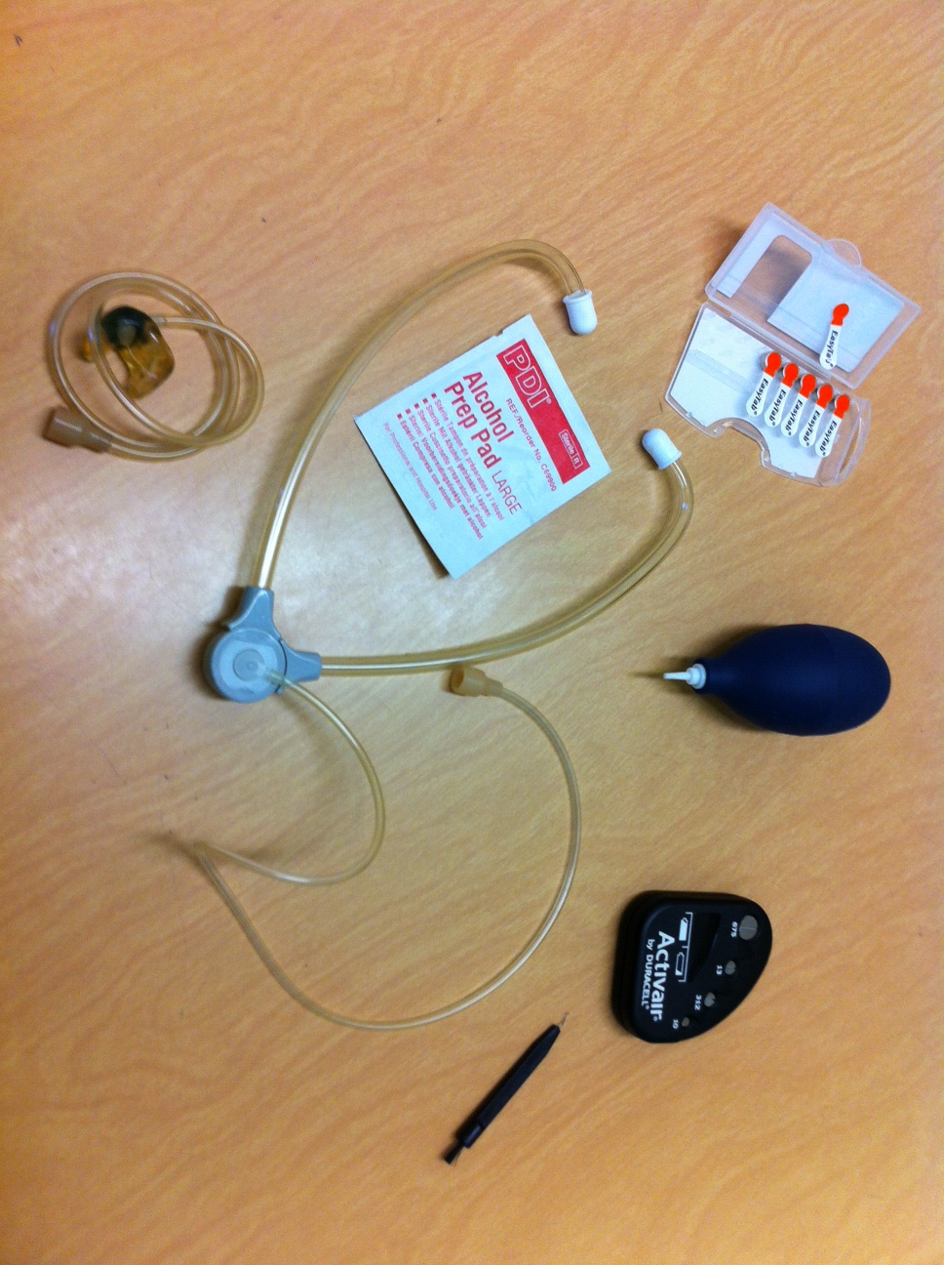
Supplies Needed:
Batteries
Blower
Battery Tester
Wax pick
Stethoscope
or listening tube

Slide 26

Hearing Aid / FM Quick Check
Each Morning
The easiest, quickest way to check the equipment…
…listen to the hearing aid with the earmold, the audioshoe and FM receiver (little cube with the 3 prongs) attached to it.
Leave the transmitter(teacher’s mic) turned off for this step

Slide 27
Can you hear your voice when the FM mic is turned off? (if so, the aid is working)
Can you hear your finger rub when the FM mic is turned on? (the FM is working)
(if no sound… change the battery… the battery may be powerful enough to run the hearing aid but not powerful enough to run the hearing aid AND the FM)
Say the Ling six sounds… oo, aw, ee, sh, s, m
Do they sound clear?
You’re done!
Yea!

Slide 28
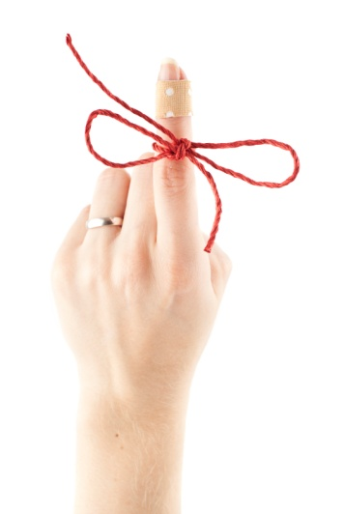
Another Tip
Can you hear your finger rub across the hearing aid’s mic? (the aid is working)
Can you hear your finger rub across the FM mic? (the FM is working)

Slide 29
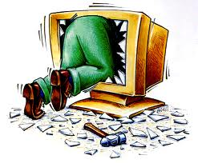
Troubleshooting

Slide 30
Does the hearing aid amplify sound when it’s turned on?
Does the hearing aid sound as loud as you expect it to?
Does the hearing aid amplify sound consistently?
(Does the sound cut in and out?)
Is the quality of the sound okay?
Is there static or distortion?

Slide 31

Does the hearing aid amplify sound when it’s turned on?
If not –
Make sure it’s in the “on” position
Check/Change the battery
Look for blockage in the earmold or tubing

Slide 32

Does the hearing aid sound as loud as you expect it to?
If not –
Check/Change the battery
Look for blockage in the earmold or tubing
Listen to the hearing aid without the earmold

Slide 33
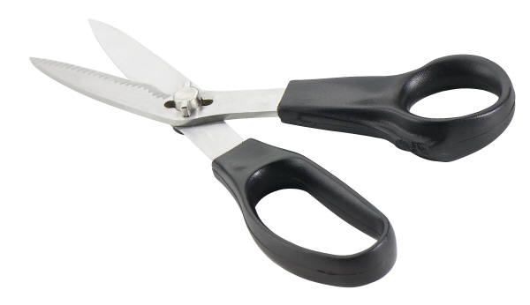
Does the hearing aid amplify sound consistently? (Does the sound cut in and out?)
If not –
Check/change the battery
Check the battery compartment and FM contacts for corrosion

Slide 34


Is the quality of the sound okay? Is there static or distortion?
If not –
Check/change the battery
Check the battery compartment and FM contacts for corrosion

Slide 35

Listen to the hearing aid as you say the Ling sounds (ah, ee, oo, mm, sh, s) Do the they sound clear?
If not –
Check/change the battery
Check the battery compartment and FM contacts for corrosion

Slide 36
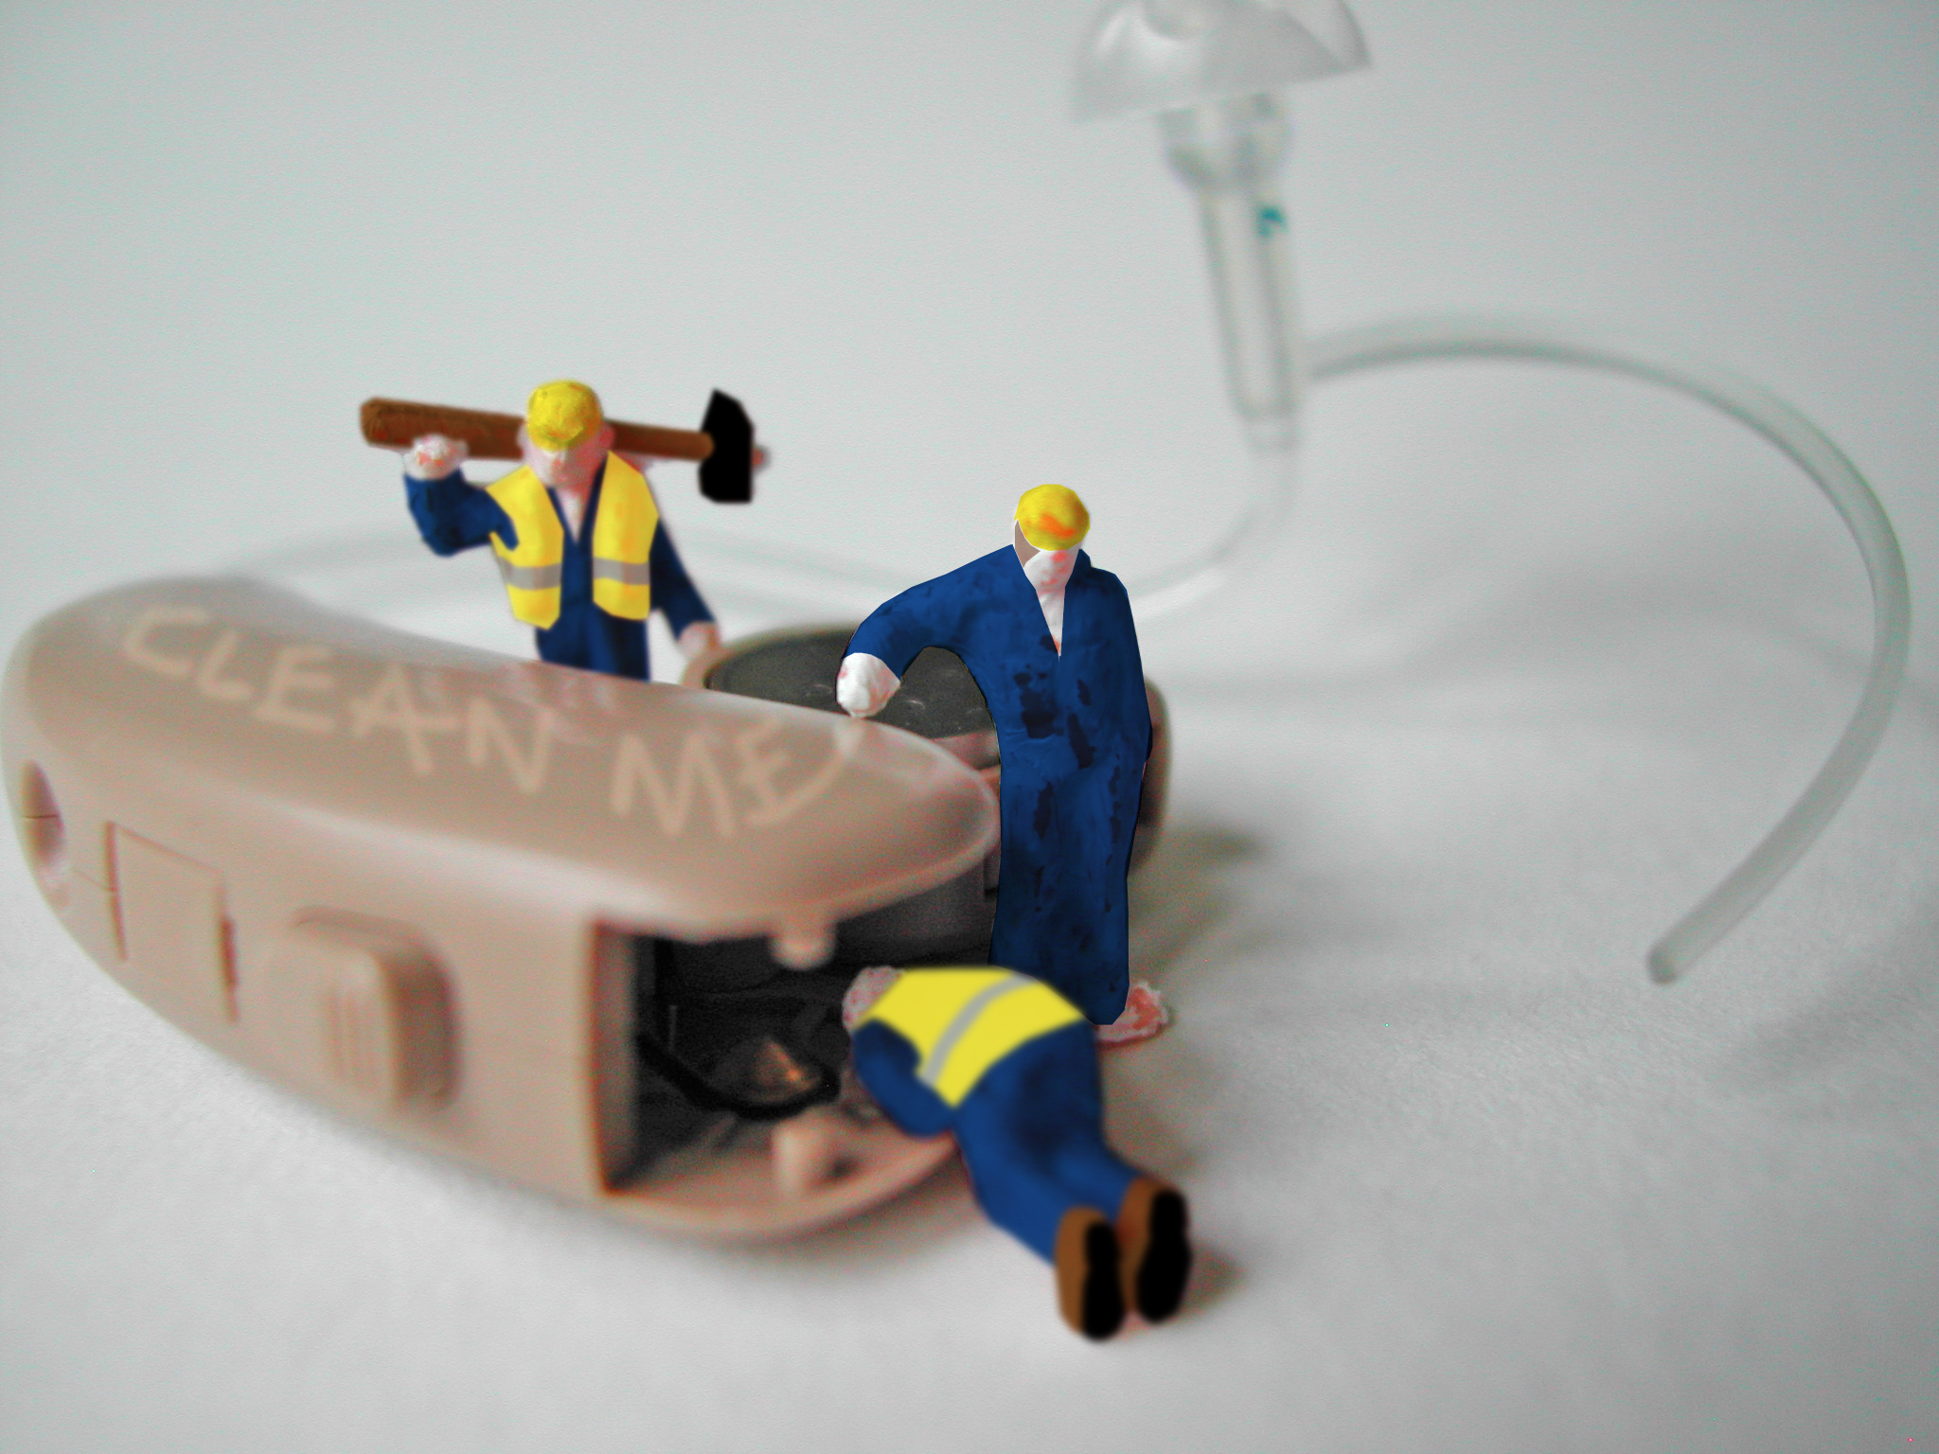
It still doesn’t work……now what?

Slide 37
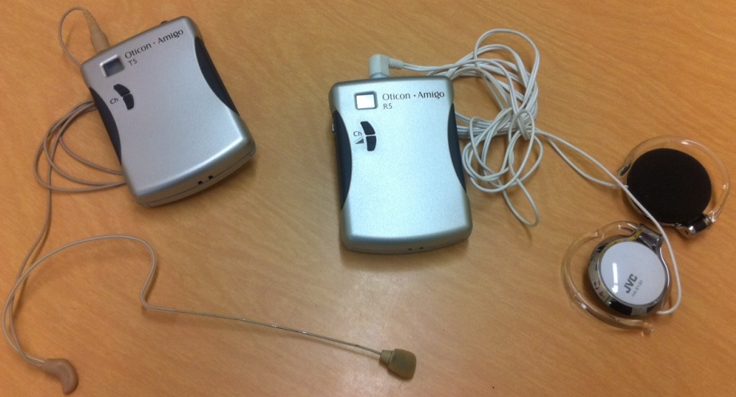

Is the transmitter on the right channel?
And, is the battery fully charged?

Slide 38
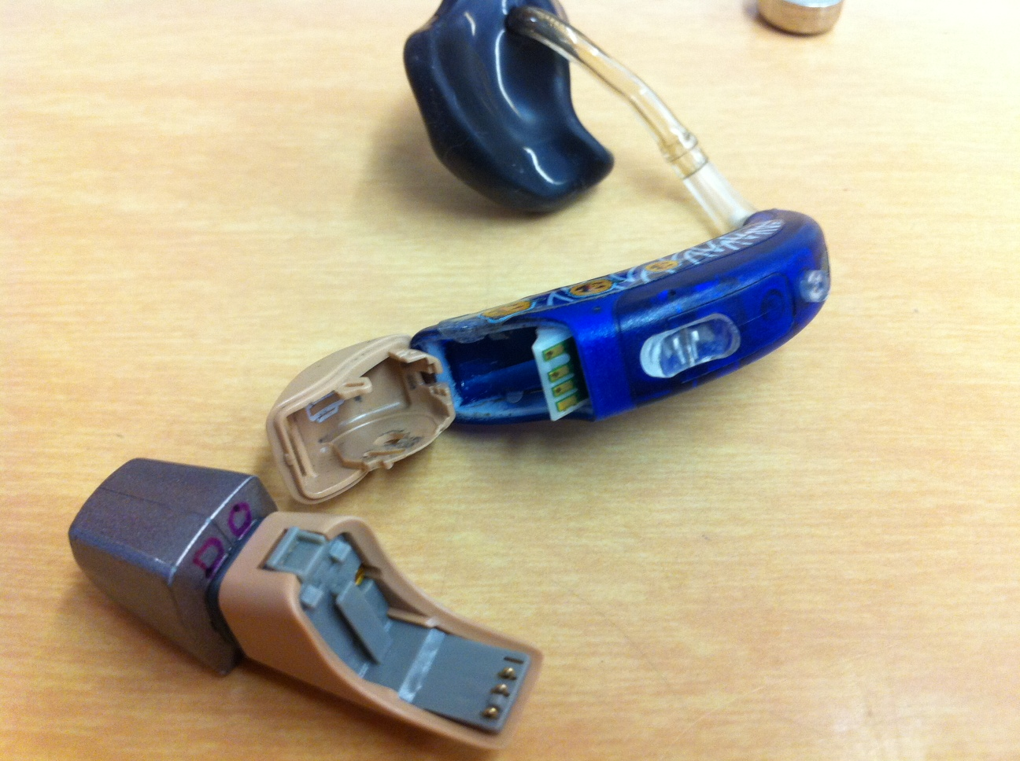
Are the contacts on the audio shoe dirty or broken?
Sometimes, the contacts have tiny bits of dust or grime
They can easily be cleaned by rubbing a pencil eraser over the contacts, or by cleaning with an alcohol prep pad

Slide 39
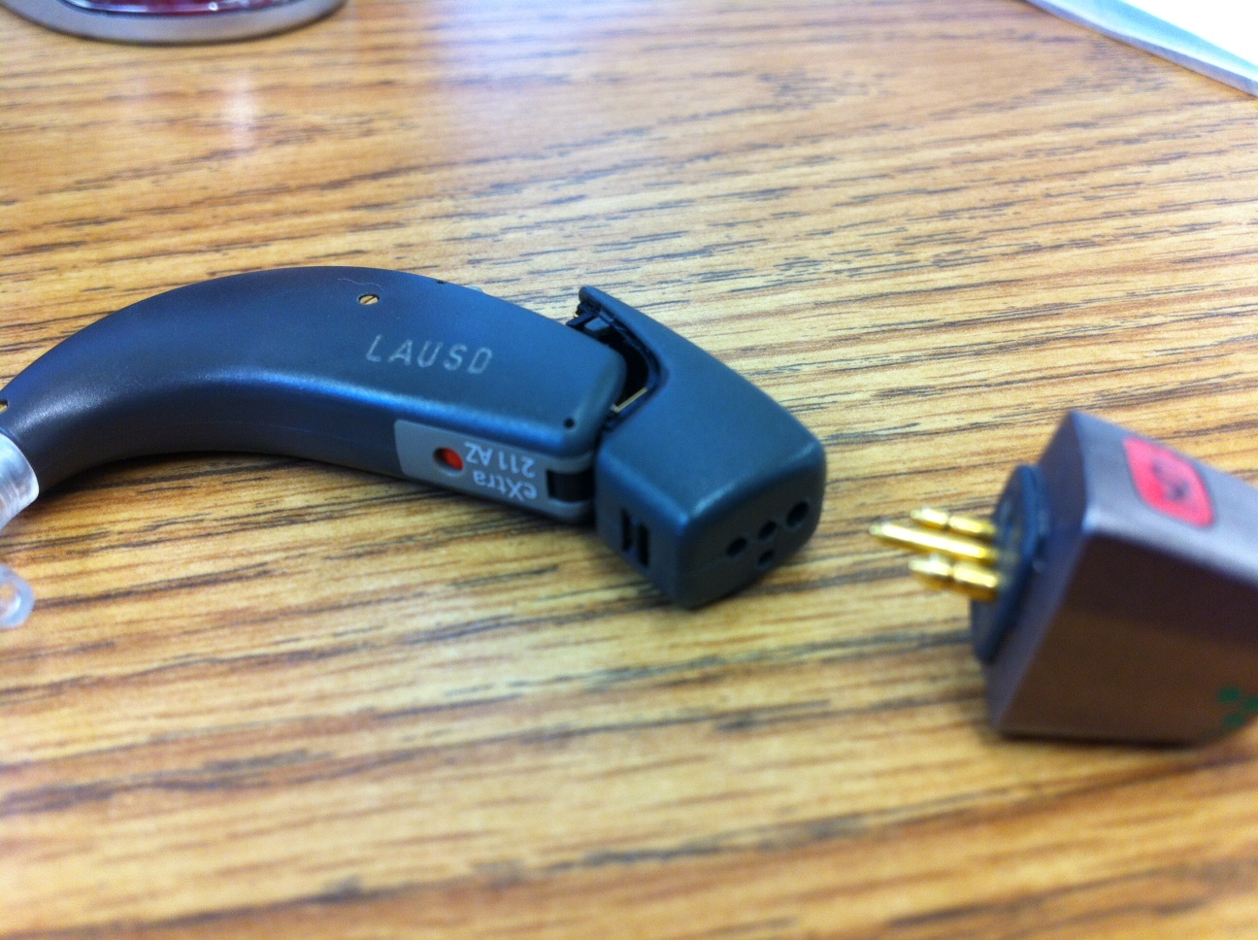
Are the FM receivers attached to the hearing aids?
Audio shoe
FM receiver
(Remember to call each piece the right name)

Slide 40
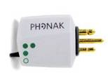
Is the toggle on the FM receiver in the correct position?
Put the MLX cube switch to the two dot position (FM + mic)
Turn on the FM mic (teacher’s transmitter)
Rub your fingernail across the teacher’s mic and listen for the FM to pick it up
FM + mic
FM only
HA only (FM off)

Slide 41
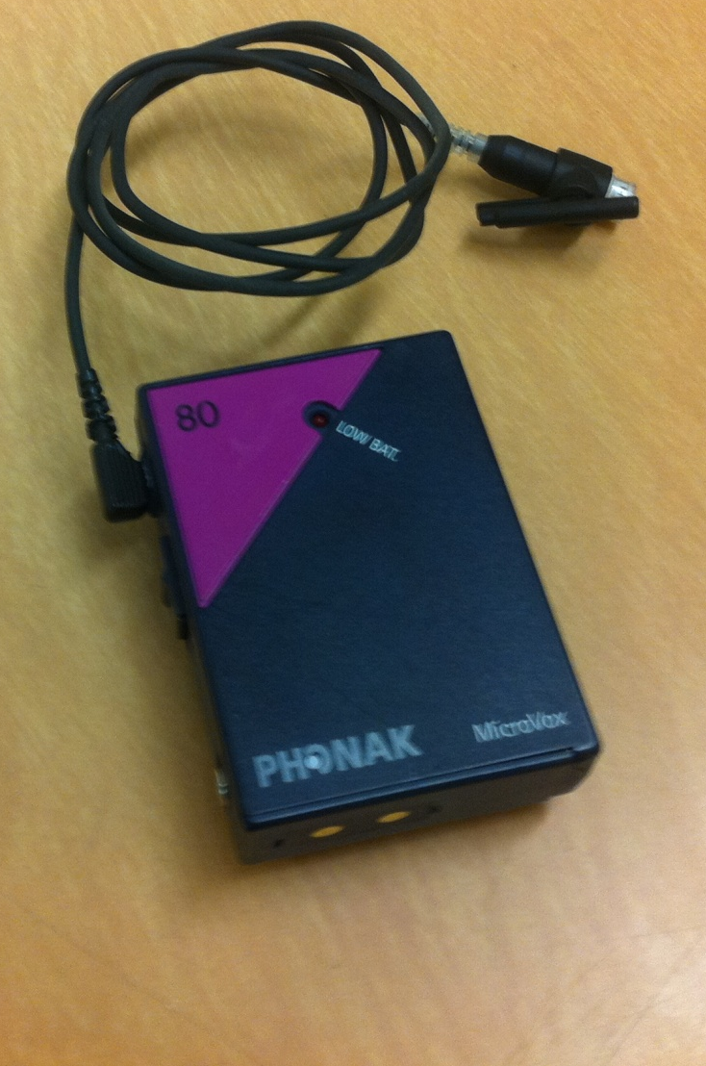
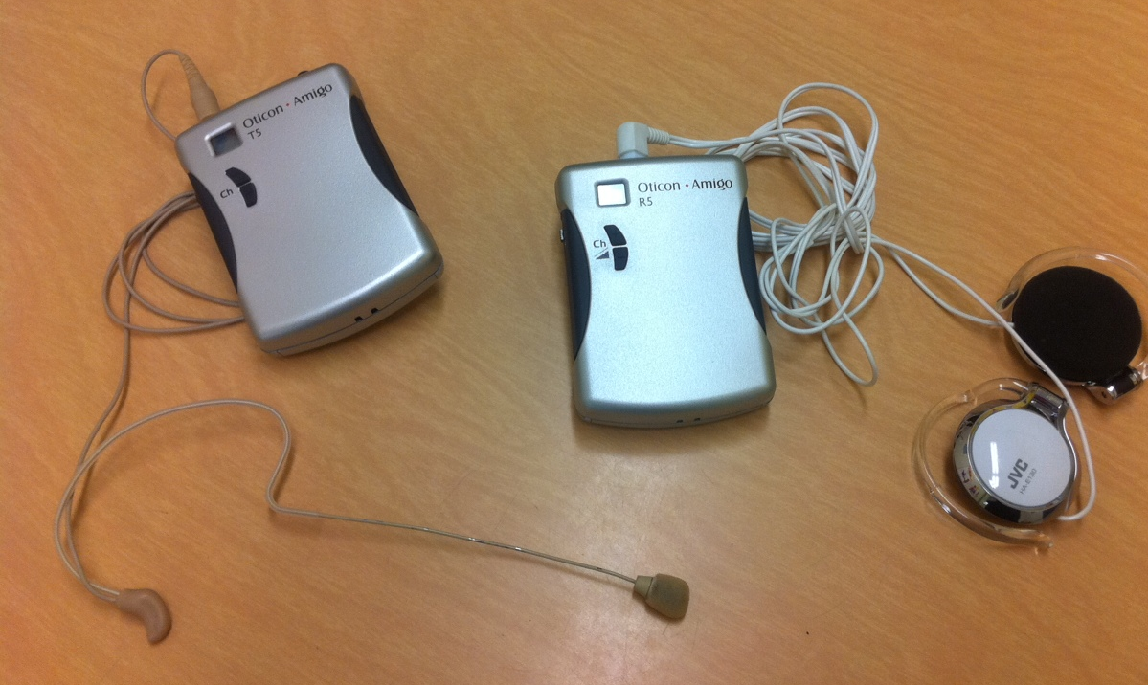
Are the cords in good shape and plugged in completely?

Slide 42
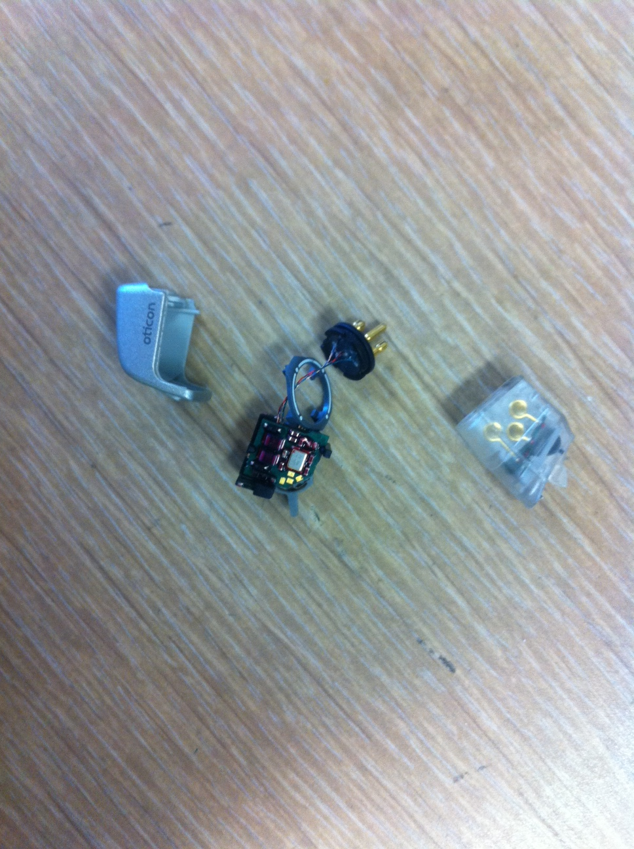
And sometimes, it’s just broken!!

Slide 43
Thanks to Gwen Severance, AuD & Patty Klein, AuD for developing this presentation and sharing it with others!
References:
http://www.txsha.org/_pdf/Convention/2010Convention/Wickesberg,%20Jennifer%20-%20Do%20You%20Hear%20What%20I%20Hear%20A%20Hands%20on%20Tutorial.pdf
https://successforkidswithhearingloss.com/resources-for-professionals/impact-on-listening-and-learning

